Slide 1
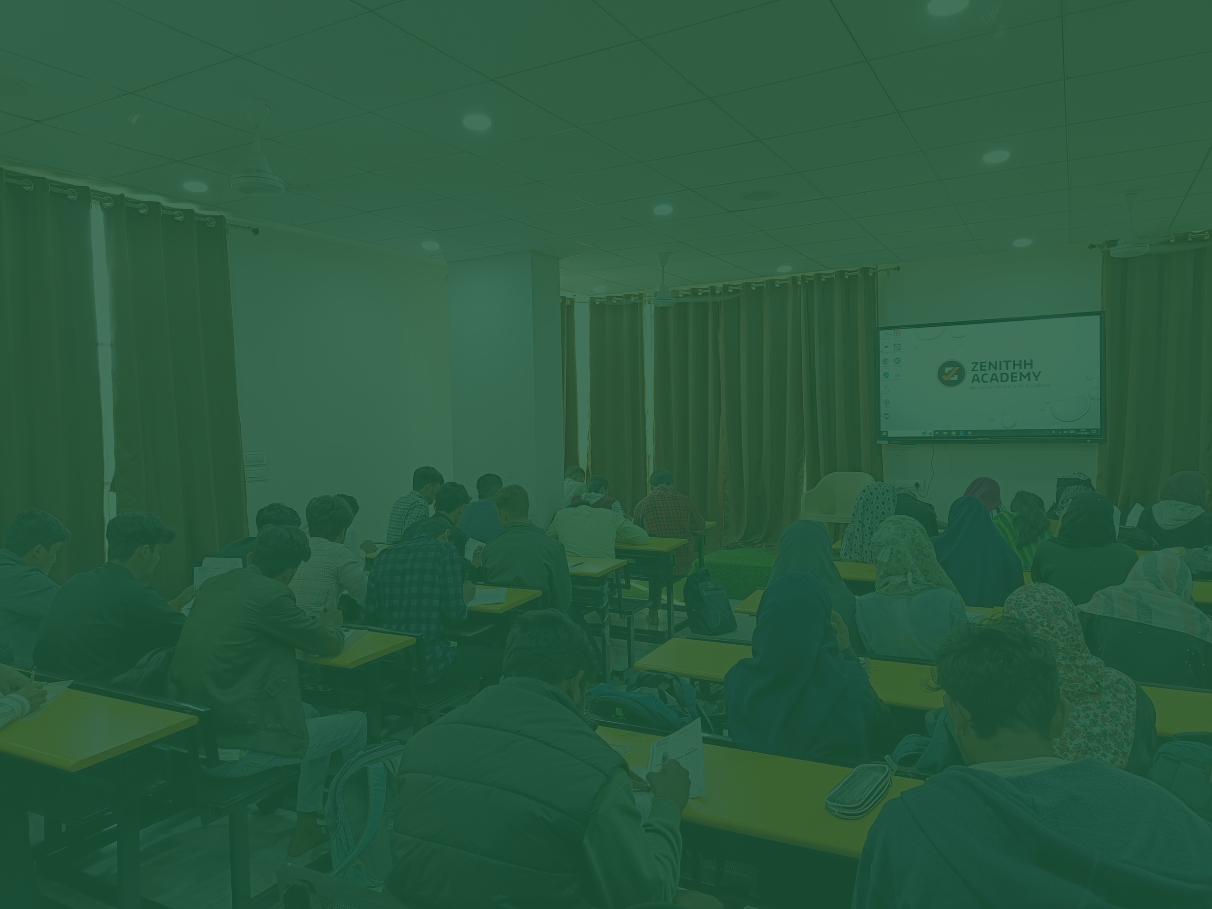

ZENITHH
ACADEMY
Rise Above the rest with Excellence.

Slide 2

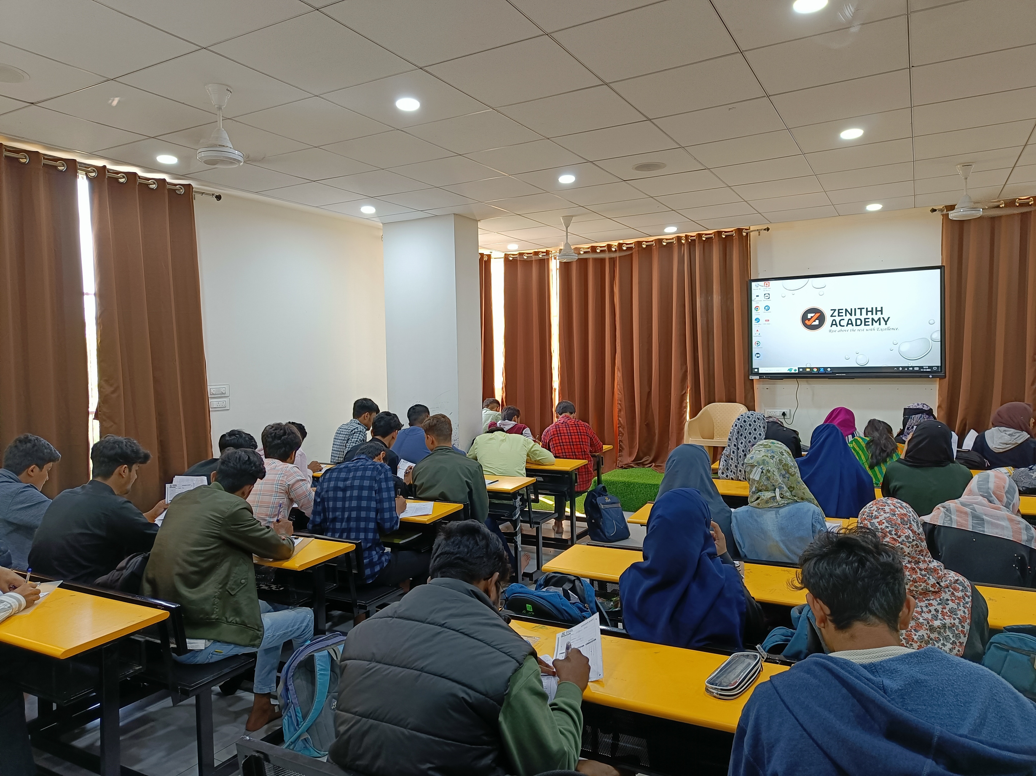

ZENITHH
ACADEMY
Rise Above the rest with Excellence.

Slide 3

About Us.
was founded in 2021 by a group of like-minded teachers already engaging individual classes. Since past 30 years and have been blessed by a very large number of students who have qualified for MBBS / BDS as well as various field of engineering including IIT. The academy feels really grateful to the society for its support throughout, we intend to serve you even better.
Zeni﻿thh Academy
Rise Above the rest with Excellence.

Slide 4





Rise Above the rest with Excellence.
To give quality education within Vicinity
To... Blossom Academic growth and all-round personality of the student to be developed
Vision & Mission
To provide Healthy and Congenial learning atmosphere
Quality and Modern technology aided learning ambience
To help Fulfill dream of hard working and aspirant student in career building.

Slide 5



ZENITHH FEATURES.
Well Experienced and Expert Faculties
Personalized attention
No teaching without learning
weekly test series
Fortnightly Grand Test
100% Result oriented
Target oriented all India level study material

Slide 6

ZENITHH FEATURES.
Digital Classroom (Smart Board)
Doubt solving session
Parent teachers meeting
Secure campus with surveillance
Within the city limits far from traffic hazard
Wi-Fi facility
Study Centre (Library / reading room)

Slide 7


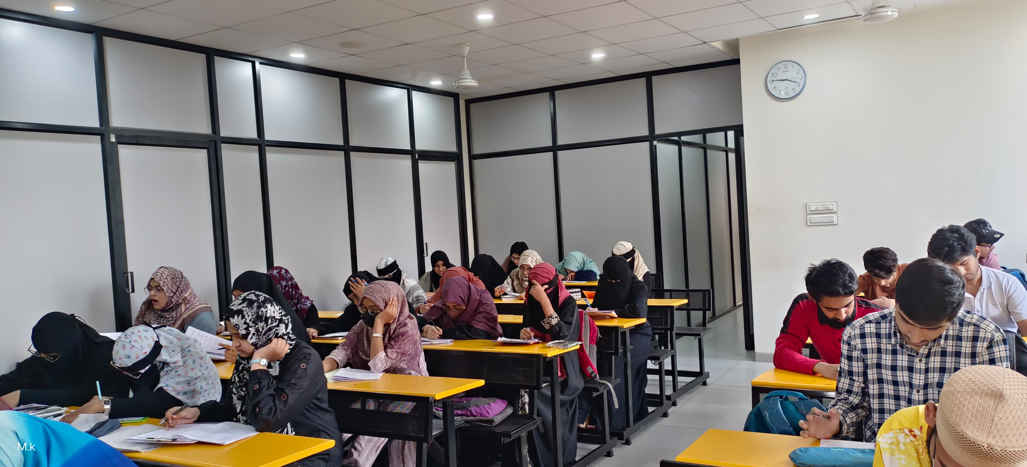
Zenithh Academy
Test Series and Grand Test
Rise Above the rest with Excellence.

Slide 8
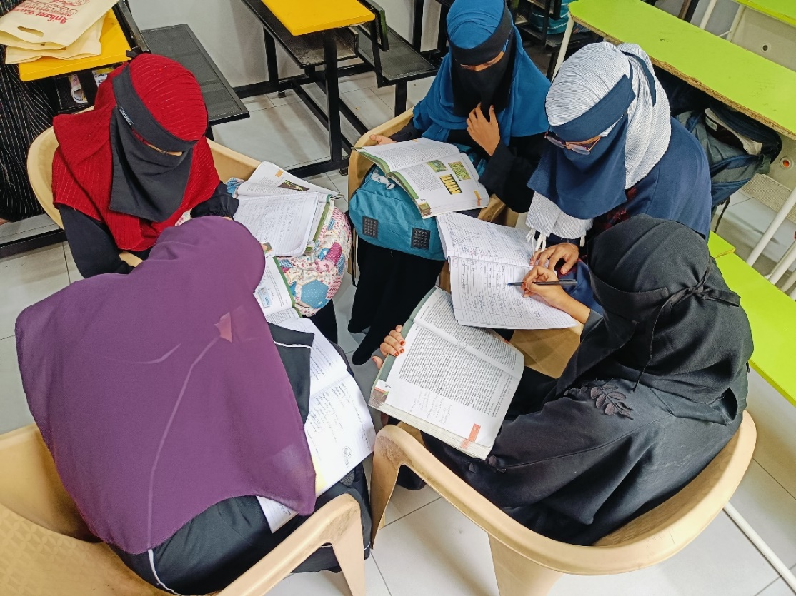
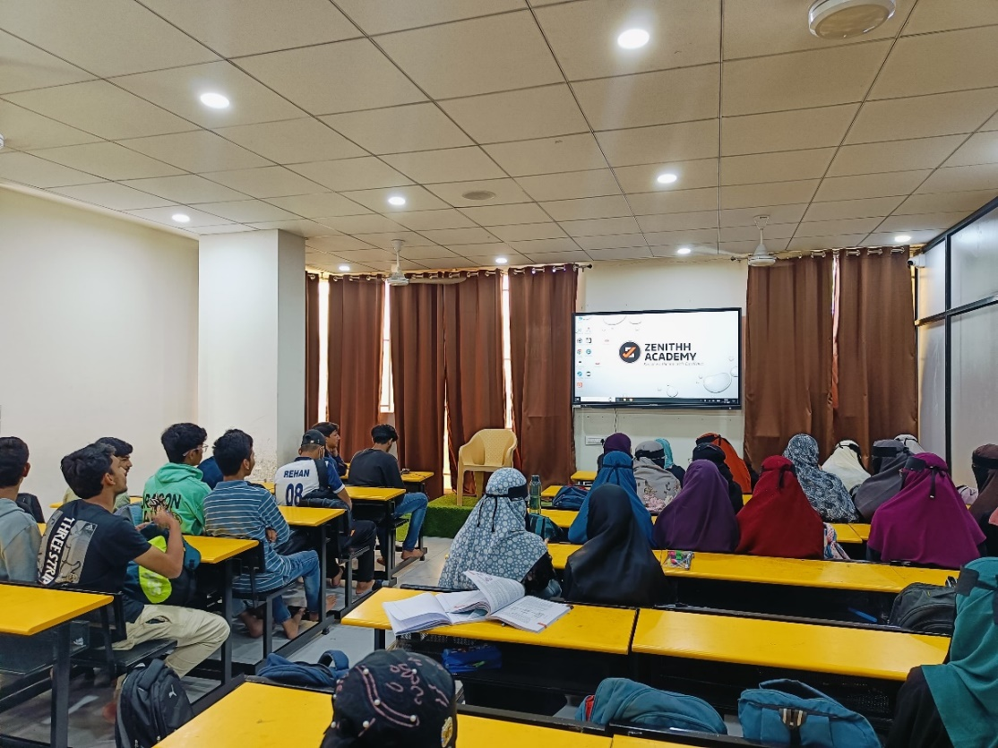
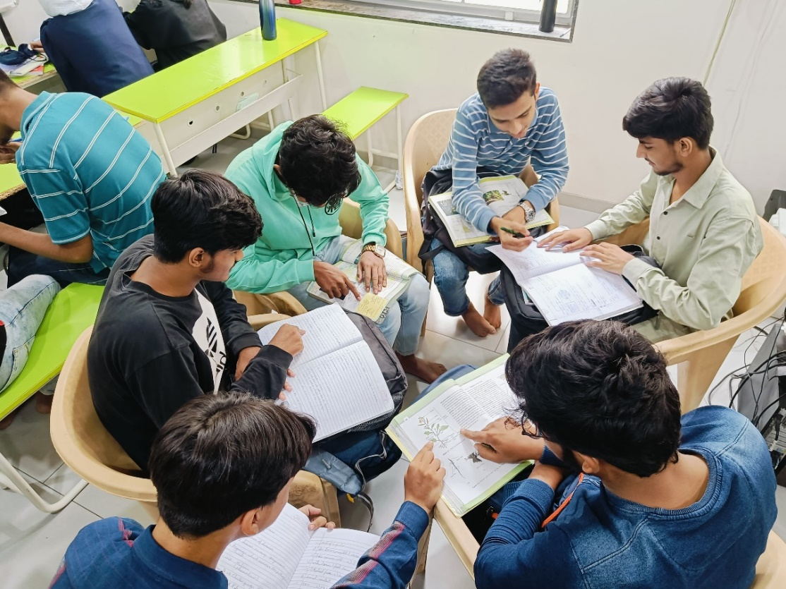
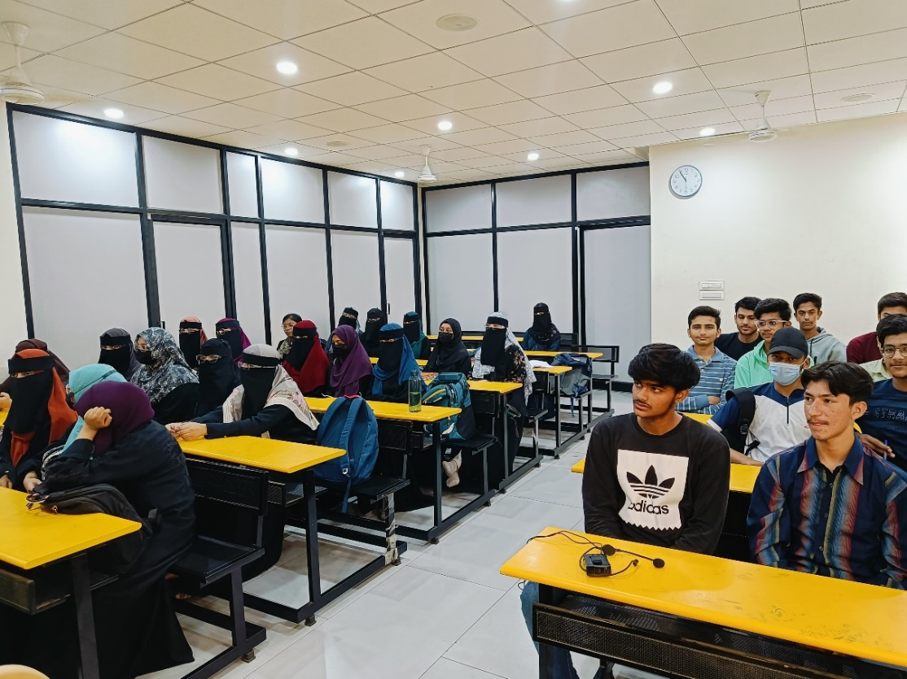
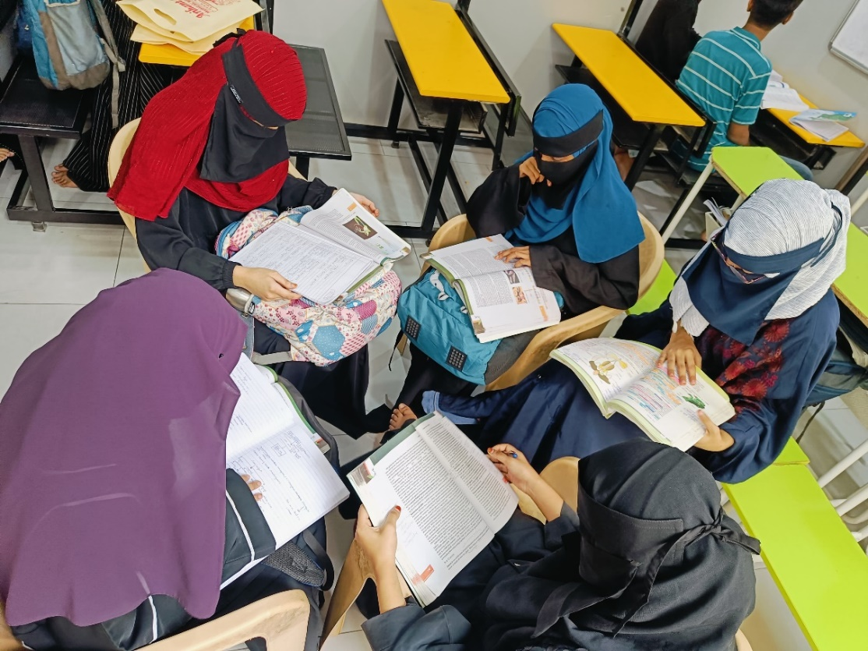
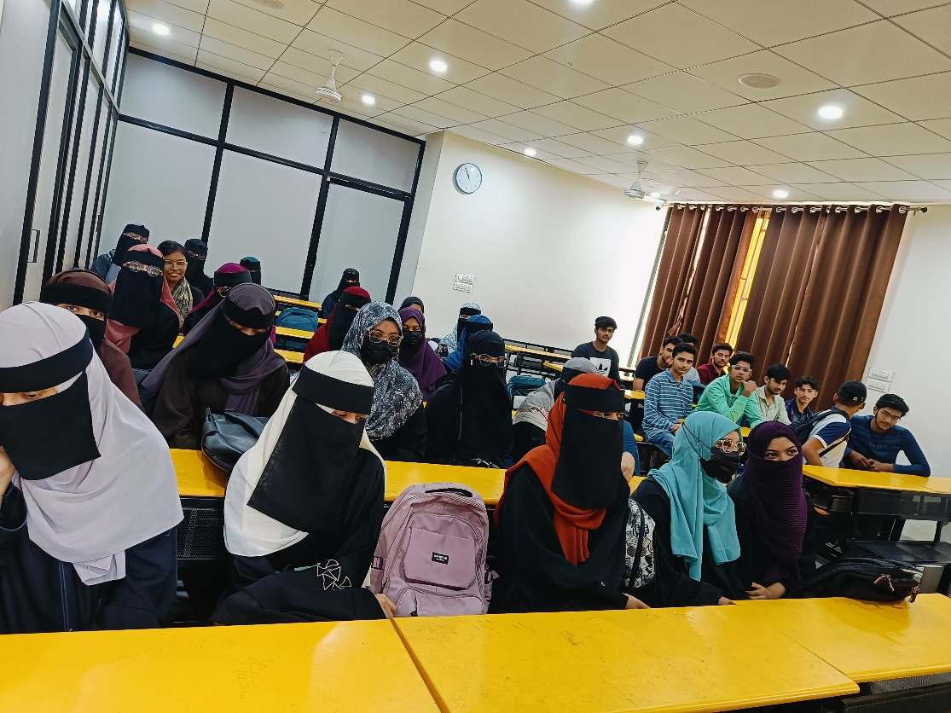
Group Discussion Sessions
ZENITHH
ACADEMY

Slide 9



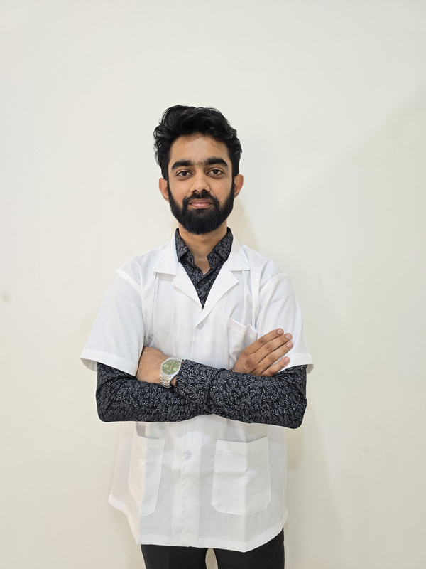
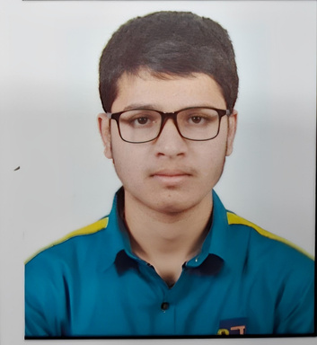
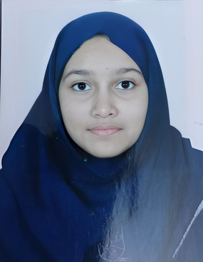
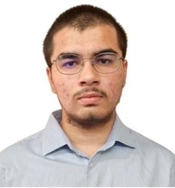
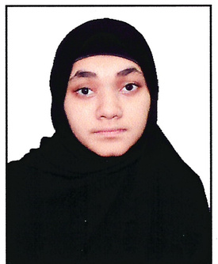


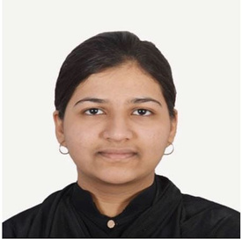
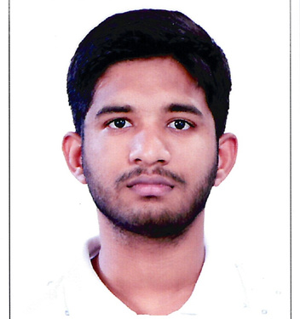
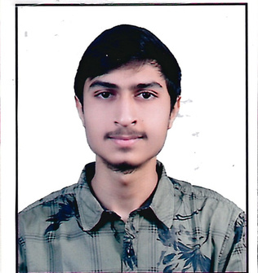

Zenithh Academy
Results 2024
2024
2024
2024
2024
2024
SANAWAR KHAN
NEET 670 / 720
NOMAN SIDDIQUI
NEET 641 / 720
UMME KULSUM
NEET 614 / 720
KHAN ZAYEEM
NEET 595 / 720
MAIMUNA QUAZI
NEET 593 / 720
2024
2024
2024
2024
KHAN LAMATUNNOOR
NEET 578 / 720
NABEEL SHAIKH
NEET 544 / 720
IBAADUDDIN BAAG
NEET 528 / 720
ABUDUL RAFE AHMED
JEE 97.98 %tile

Slide 10
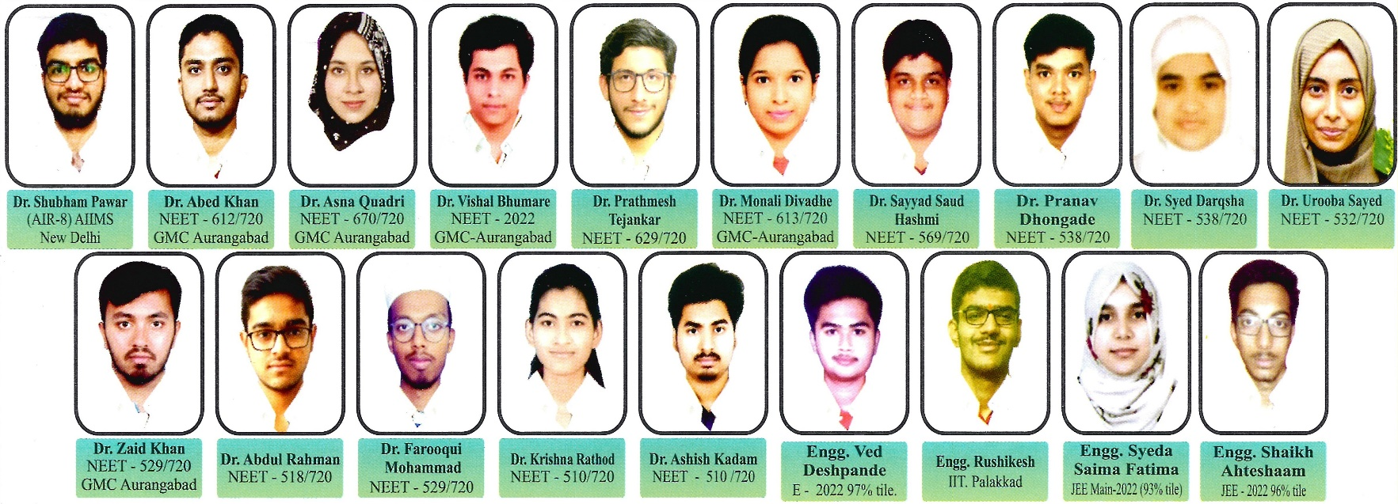
Zenithh Academy
Previous Results
Rise Above the rest with Excellence.

Slide 11


ZENITHH
ACADEMY
Rise Above the rest with Excellence.
8304889629
9226967646
Address
Y.N Tower Opposite Pacific Hospital Maulana Azad College Road,
Himayat Bagh, Aurangabad, (Chh. Sambhaji nagar) Maharashtra.

Slide 12



Rise Above the rest with Excellence.
THANK YOU
FOR YOUR NICE PRESENCE
Contact No.
Address
Mail ID.
8308489629
9226967646
Y.N Tower Opposite Pacific Hospital Maulana Azad College Road, Himayat Bagh, Aurangabad,
(Chh. Sambhaji nagar) Maharashtra.
zenithhacademy@gmail.com
Jun 2024

